Slide 1
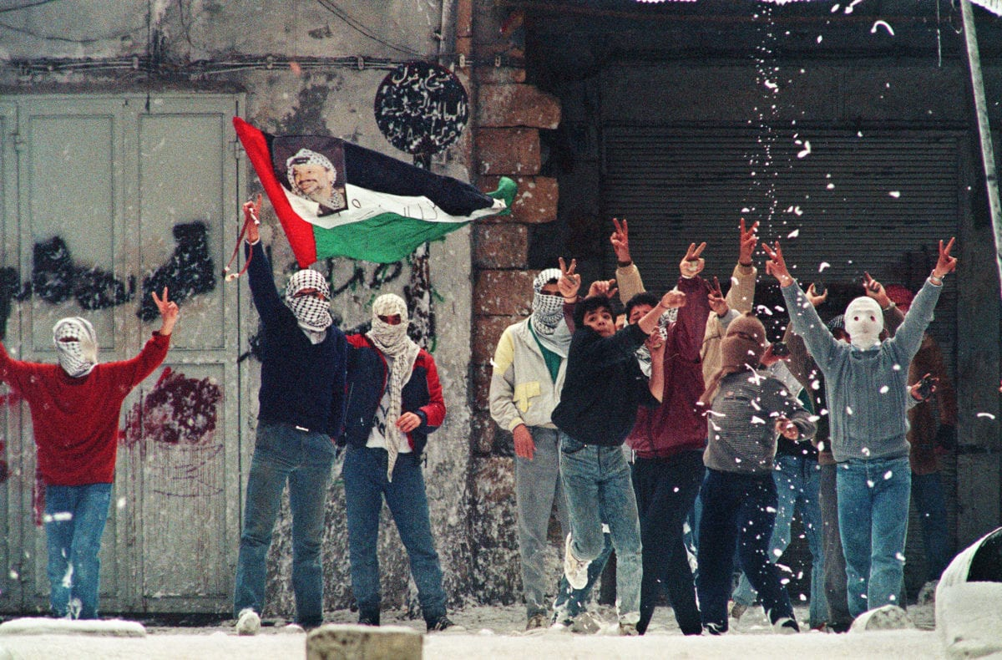
What were the causes and consequences of the First Intifada?
Lesson 11

Slide 2
Learning objectives
By the end of this lesson, you should be able to:
Describe what happened during the First Intifada
Explain the causes of the First Intifada
Discuss the consequences of the First Intifada

Slide 3
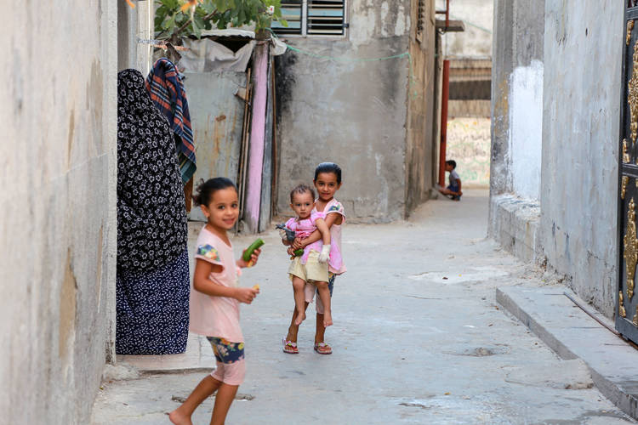
11a. Keywords
Cut out the cards and match each keyword with a definition and an image
an Arabic word meaning shaking off, uprising or rebellion
First Intifada, 1987-1993
when people in a community come together to take action, often in the absence of traditional political leadership
انتفاضة
Jabalia Camp
a refugee camp in Gaza. This is the biggest Palestinian refugee camp and one of the most densely populated places on earth
Intifada
Grassroots movement
A massive uprising of Palestinians against Israel’s ongoing occupation of the West Bank and Gaza

Slide 4
11a. Keywords
Cut out the cards and match each keyword with a definition and an image
First Intifada, 1987-1993
A massive uprising of Palestinians against Israel’s ongoing occupation of the West Bank and Gaza
Jabalia Camp
a refugee camp in Gaza. This is the biggest Palestinian refugee camp and one of the most densely populated places on earth
Intifada
an Arabic word meaning shaking off, uprising or rebellion
انتفاضة
Grassroots movement
when people in a community come together to take action, often in the absence of traditional political leadership
Stick the answers into your glossary

Slide 5
Recap
Working with the person next to you, use your notes from Lesson 9 to answer the questions below using the vocabulary provided
1) What were the consequences of the June 1967 War for the West Bank and Gaza?
2) What did this mean for the daily lives of Palestinians in the West Bank and Gaza?
As a consequence of the June 1967 War, which Palestinians call the Naksa (meaning ‘setback’), the West Bank and Gaza were occupied by Israel, which meant that the Palestinians living there were now living under Israeli military rule
Life became even more difficult after 1967. Thousands of Israelis moved to the West Bank and Gaza, where they established settlements, taking the land from Palestinians. Palestinian homes were demolished and any Palestinians considered a threat to Israel were arrested and imprisoned, often without trial
Naksa
Occupied
Israeli military rule
Settlements
land

Slide 6
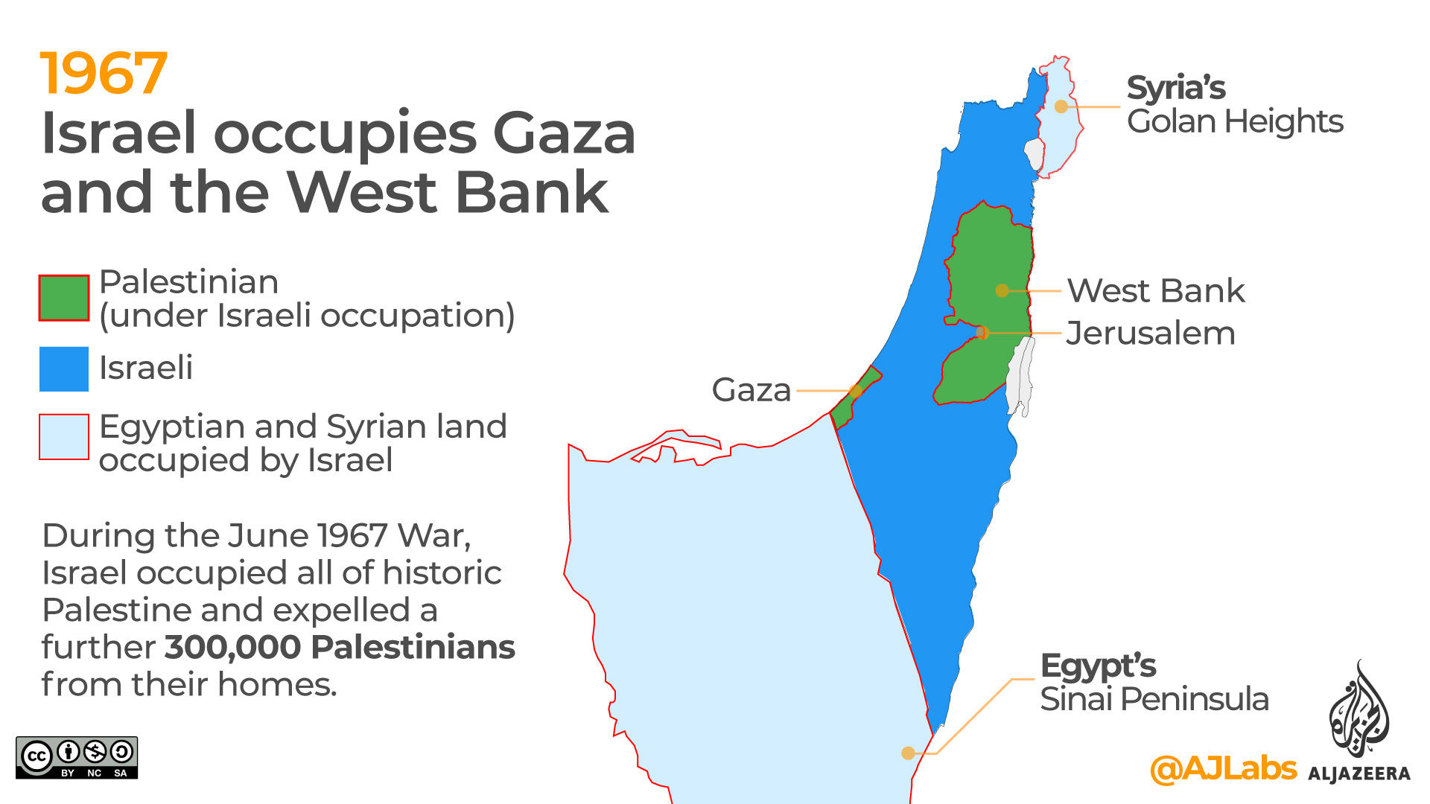

Slide 7
First Intifada, 1987-1993: A massive uprising of Palestinians against Israel’s ongoing occupation of the West Bank and Gaza The causes

Slide 8
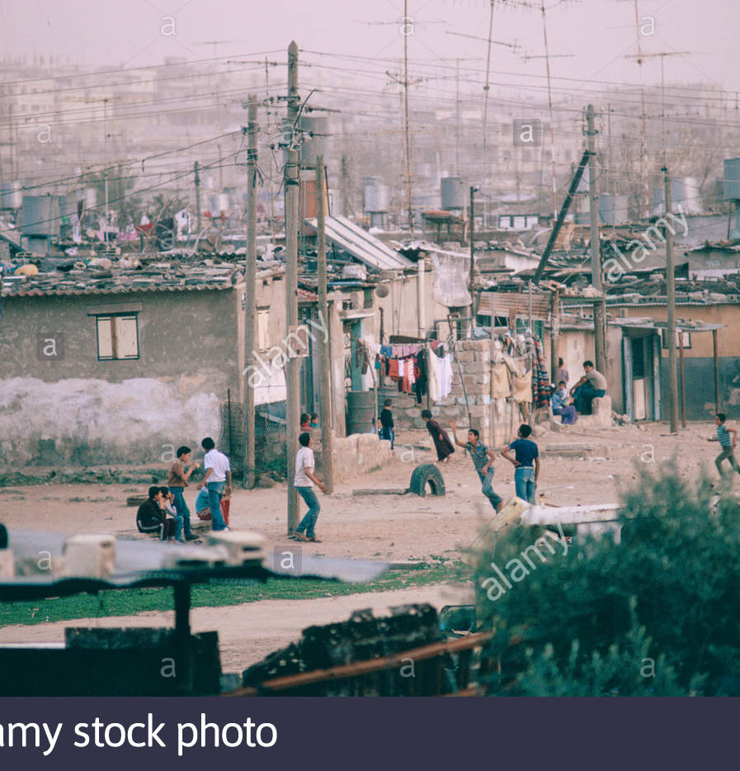
Palestinian living conditions in the West Bank and Gaza
As we have seen, life was very difficult for Palestinians in the West Bank and Gaza after 1967
Palestinians lost their homes whilst thousands of Israelis established settlements
Palestinians were also arrested and imprisoned by the Israeli military, often without trial
As the Palestinian population increased but Palestinian land was reduced, the West Bank and Gaza became dangerously overcrowded (and unhygienic as a result)
Also, due to the economic restrictions placed on Palestinians by Israeli rule, there were very few jobs available and high unemployment

Slide 9
According to historian Benny Morris, life for Palestinians under Israeli occupation in the West Bank and Gaza at this time was characterised by: “brute force, repression and fear, collaboration and treachery, beatings and torture chambers, and daily intimidation, humiliation, and manipulation” Benny Morris, Righteous Victims (1999) How does this make you feel?

Slide 10
Increasing tension
Between 1967 and 1987, tension increased and there were numerous attacks by both sides. For example:
The Coastal Road massacre of 11th March 1978, when 38 Israelis (including 13 children) were killed by Palestinian nationalists
Operation Litani in March 1978 when 1100 Palestinians and Lebanese were killed during an Israeli invasion of south Lebanon
On 8th December 1987, four Palestinians were killed in a collision with an IDF truck in Jabalia refugee camp, Gaza (pictured)
Jabalia is the largest Palestinian refugee camp and one of the most densely populated places on earth (in 2002, over 100,000 people lived in an area of land 1.4 km²)
For the Palestinians, this was the final straw: the First Intifada now began

Slide 11
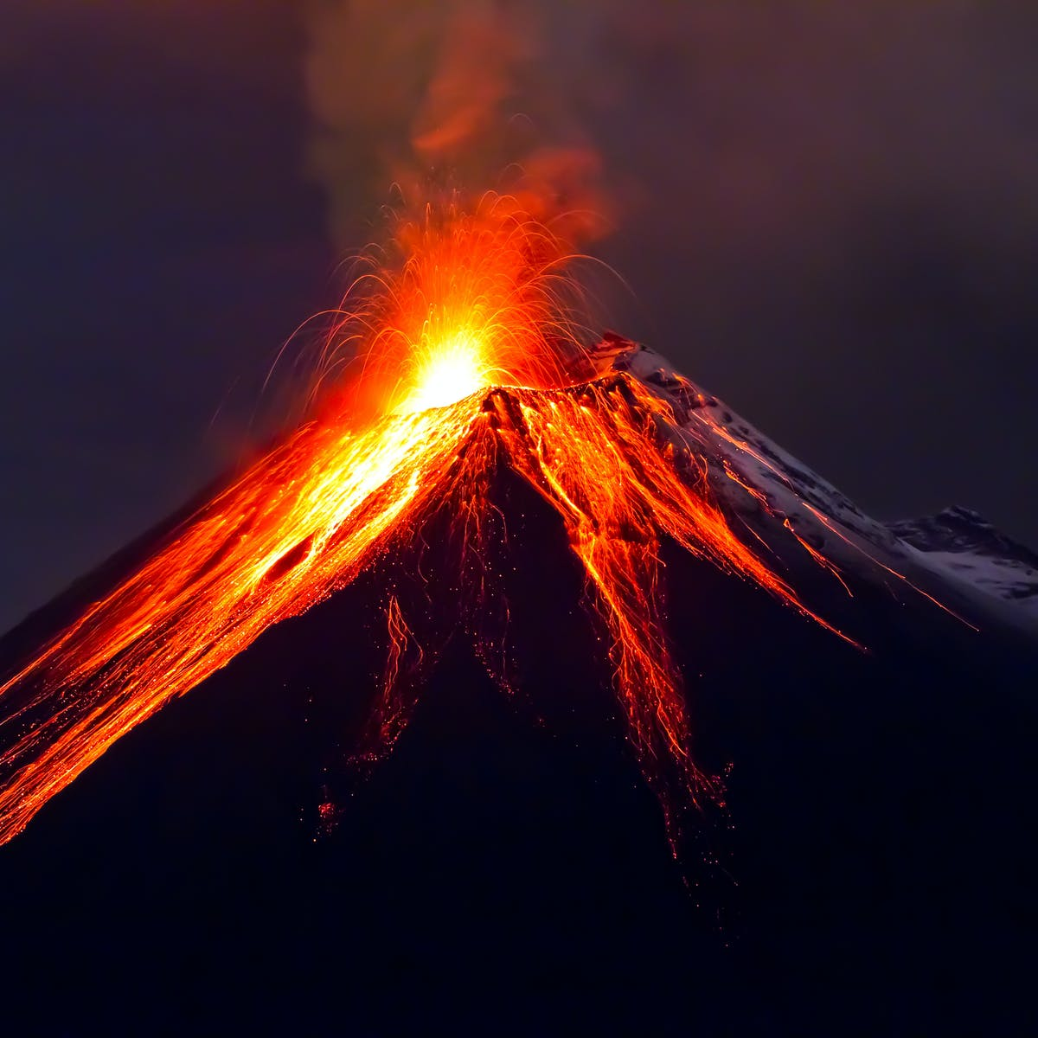
11b. Volcano activity
The First Intifada
(1987-1993)
What were the causes of the First Intifada?
Use your existing knowledge and the information provided to complete the volcano
Trigger cause:
Extension question:
Which long-term cause was the most significant? Why?
Short-term causes:
Long-term causes:

Slide 12
11c. What happened during the First Intifada?
8th December 1987: four Palestinians were killed in a collision with an IDF truck in Gaza
The funerals of the four Palestinians turned into demonstrations against Israeli occupation
Over the next few weeks, these demonstrations spread across Gaza and the West Bank
These were widespread, grassroots demonstrations: Palestinian men, women and children came together from all over, but they were not led by the PLO
Most of this was peaceful and non-violent
Stones and petrol bombs were also thrown at the IDF
11c. Read the information and answer these questions:
a. How did the First Intifada start?
b. Which parts of Palestinian society took part in the demonstrations?

Slide 13
11c. What happened during the First Intifada?
The Israeli response was brutal violence: Israel deployed 80,000 soldiers across Gaza and the West Bank
These soldiers shot even peaceful protesters and beat Palestinian children
53 Palestinian children were killed by IDF soldiers in the first year of the Intifada, and many more children had their bones broken by the IDF
The international community said this had to stop! Israel switched to using plastic bullets instead, but these still caused horrible injuries – by 1993, 1,200 Palestinians had been killed and 130,000 Palestinians had been injured
Read the information and answer these questions:
c. How did Israel respond to the Palestinian demonstrations?
d. Why was this criticised?

Slide 14
11c. What happened during the First Intifada?
A group of Palestinians soon created the Unified National Leadership of the Uprising (UNLU) to coordinate the demonstrations and boycotts. What is a boycott?
Boycott: the decision not to use or buy something, usually for political reasons. This is an important nonviolent expression of protest
Add boycott to your glossary
In this stage of the Intifada, Palestinians boycotted Israel: they wouldn’t buy Israeli products, work in Israel or pay Israeli taxes
Eventually, talks between Israel and the PLO took place at the Madrid Conference of 1991. But it was not until 1993 that (limited) agreements were reached in the Oslo Accords – we’ll look at this next lesson
Read the information and answer these questions:
e. What does UNLU stand for? What did UNLU organise?
f. When and why did the First Intifada end?
Extension Question: Why is the First Intifada significant?

Slide 15
Women’s role in the First Intifada
https://www.youtube.com/watch?v=zotlaEEnSZw
Watch this video and answer this question in your books:
What was the role of women in the First Intifada?
Did anything here surprise you?

Slide 16
The role of women in the First Intifada
Often the First Intifada is seen as a male uprising by Palestinian men and boys (photos of boys throwing rocks at Israeli tanks)
But actually, women played a really important role in the First Intifada: one third of Palestinians killed were women
They organised demonstrations and boycotts across the country
Women’s groups also coordinated education and health services for Palestinians at this time
Women have been described as “the backbone of the uprising”
With the person next to you:
Why were education and health services for Palestinians important between 1987 and 1993?

Slide 17
The consequences of the First Intifada
The human impact:
1,200 Palestinians were killed
130,000 Palestinians were injured
Tens of thousands of Palestinians were imprisoned and many were routinely tortured
160 Israelis were killed
On a daily level, the economies of both Israel and Palestine suffered enormously:
Money was spent on security rather than development
Businesses collapsed
For Palestinians, schools were closed for long periods and unemployment was very high
For Israelis, tourism suffered and some began to question the occupation of the West Bank and Gaza
The First Intifada showed the strength of the Palestinian movement: even without the leadership of the PLO, the Palestinian people had united with mostly peaceful demonstrations and boycotts against the ongoing Israeli occupation
The First Intifada brought international attention to the situation in Palestine-Israel: Israel was criticised by the international community for its disproportionately violent response to the Palestinian uprising
In small groups, summarise the consequences of the First Intifada in two lists, one showing negative consequences and the other showing positive consequences

Slide 18
11d) Debating activity: You are now going to be assigned a partner. You and your partner are either in ‘support’ or ‘opposition’ to the Israeli occupation of the West Bank and Gaza. You can spend a few minutes preparing your argument. Then you will join with another pair and have a debate What can you use from this lesson and other lessons to support your argument? Make a note of the best points raised by the other side
Support for Israeli occupation of the West Bank and Gaza:
Israel took control of the West Bank and Gaza in the June 1967 War. This was a military victory for Israel. Some of this land has huge religious significance for Zionists, so Israeli settlers should be able to build homes and live here now.
Other arguments:
Opposition to Israeli occupation of the West Bank and Gaza:
This is Palestinian land. Palestinians have lived here for centuries. UN Resolution 242 says that Israel should withdraw from the territory it occupied during the June 1967 War.
Other arguments:

Slide 19
Discussion
What were the strongest arguments in support of Israeli occupation?
What were the strongest arguments in opposition to Israeli occupation?
Which arguments did you find most convincing?
Why?
Did anything surprise you?

Slide 20
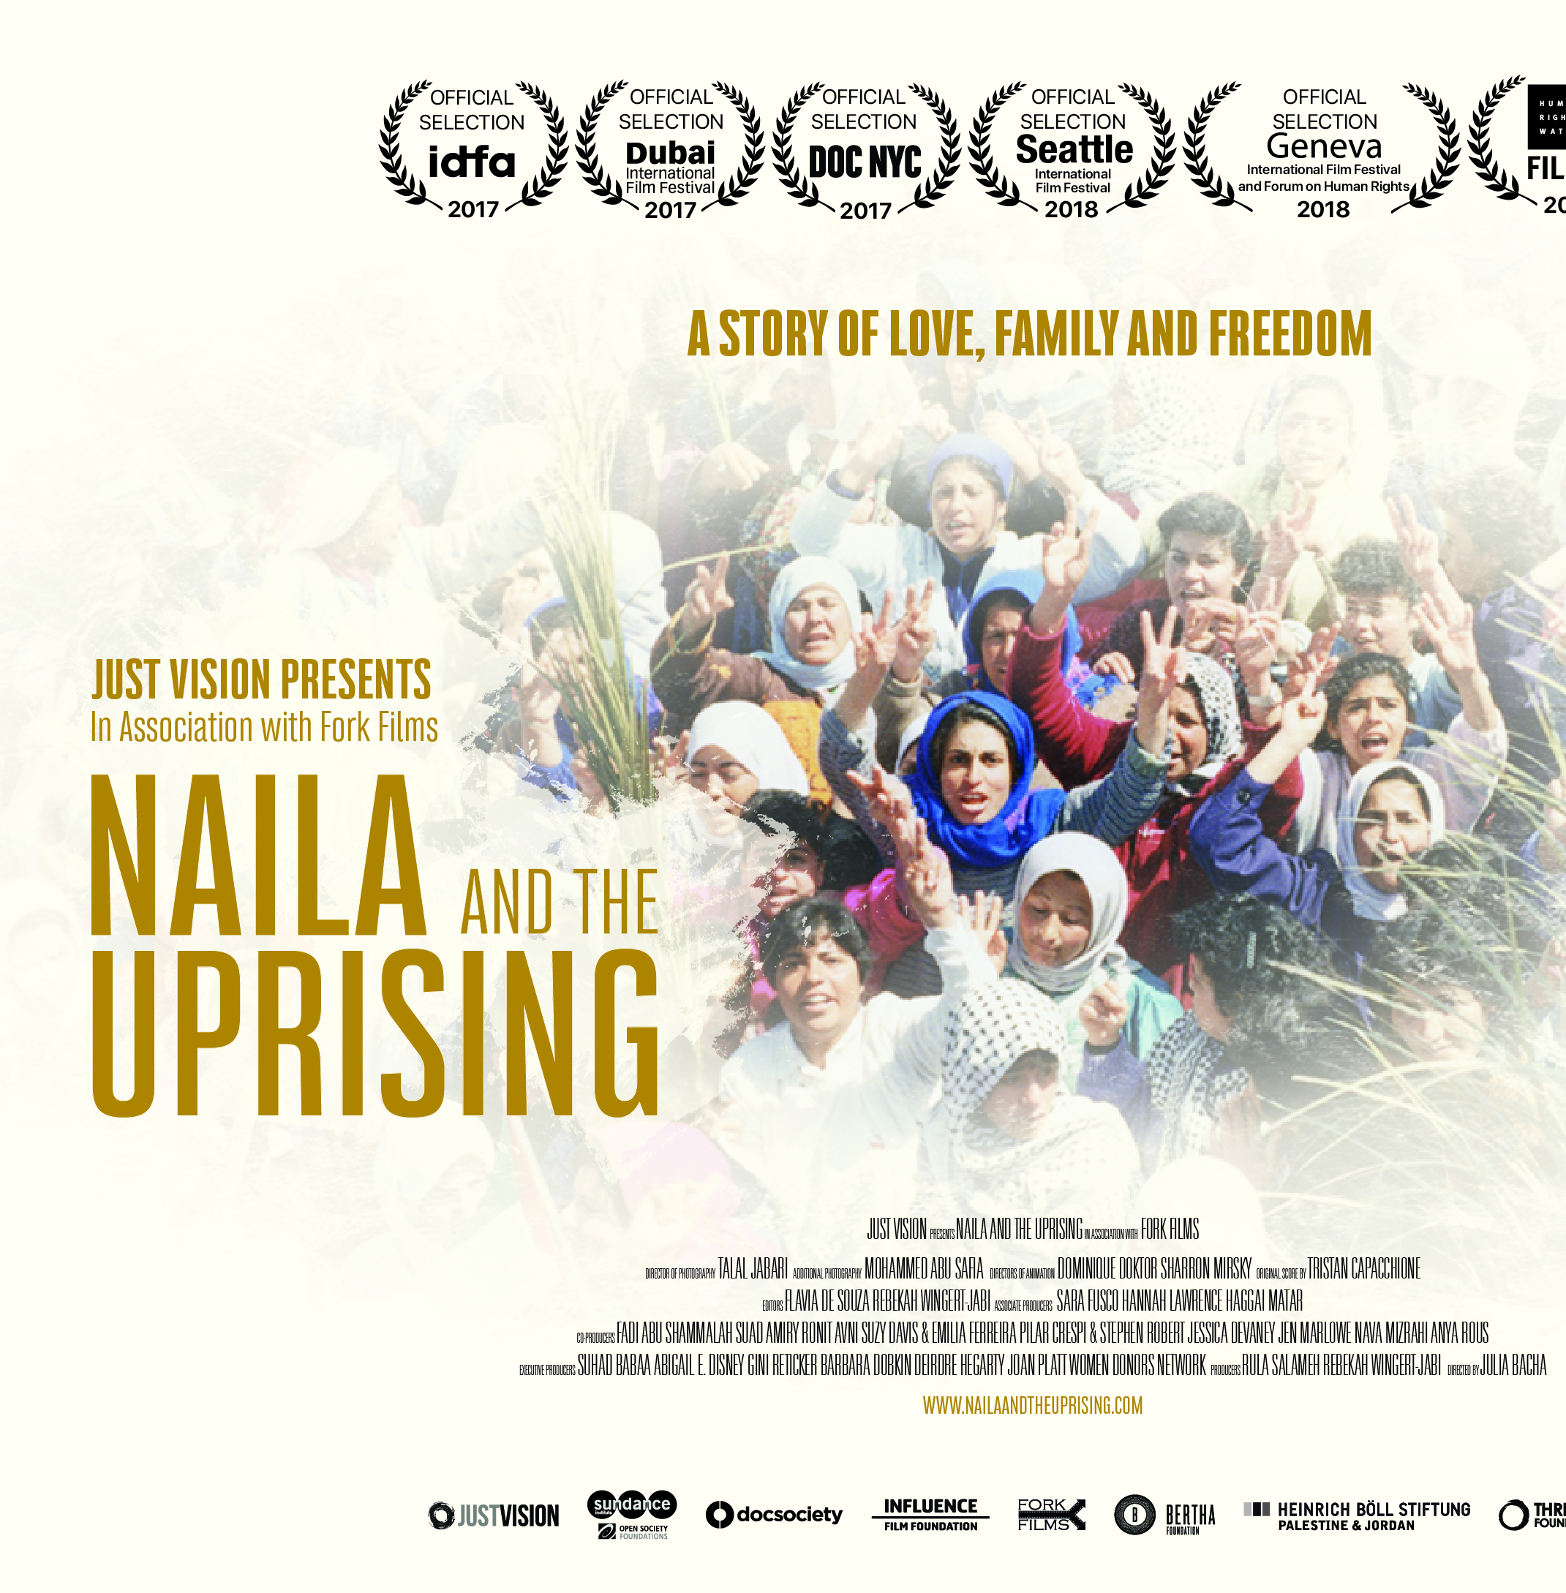
Plenary With someone you haven’t yet worked with today:
What was the trigger cause of the First Intifada? When did this happen? How long did the First Intifada last?
What were three causes of the Intifada?
What were three consequences of the Intifada?

Slide 21
Homework
Using your notes from today and the video clip below, answer these questions:
1. What was the significance of the First Intifada (1987-1993)?
Write one paragraph from an Israeli perspective and one paragraph from a Palestinian perspective
2. What does this video tell us about Yasser Arafat and the PLO?
We will come back to this next lesson
https://www.bbc.co.uk/teach/class-clips-video/gcse-history-the-first-intifada-and-palestinian-consciousness/zdwptrd

